Slide 1
Biological Modeling of Neural Networks
Week 7 – part 1 :Variability
7.1 Variability of spike trains
- experiments
7.2 Sources of Variability?
- Is variability equal to noise?
7.3 Poisson Model
-Three definitions of Rate code
7.4 Stochastic spike arrival
- Membrane potential fluctuations
7.5. Stochastic spike firing
- stochastic integrate-and-fire
Week 7 – Variability and Noise:
The question of the neural code
Wulfram Gerstner
EPFL, Lausanne, Switzerland
Notes:
First Lecture: 7.1, 7.2, and 7.3 (HOMOGENEOUS Poisson Model). Dann um 9:50h vor der Pause, Exercise 1 (Poisson Model)
Second Lecture: 7.3 (INHOMOGENEOUS Poission model, Quiz 1, and three definitions of rate). Quiz 2, five minutes before the end.
Third Lecture: 7.4 Stochastic spike arrival, on the blackboard, then exericise 2

Slide 2

Neuronal Dynamics – 7.1. Variability
motor
cortex
frontal
cortex
visual
cortex
to motor
output

Slide 3
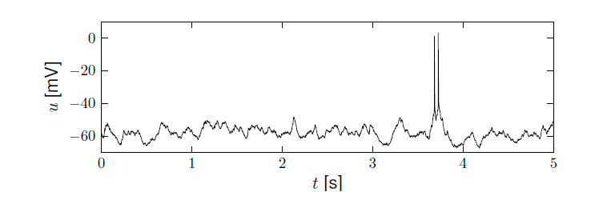
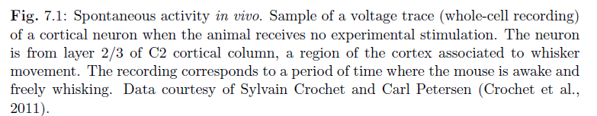
Neuronal Dynamics – 7.1 Variability in vivo
Variability
- of membrane potential?
- of spike timing?
Spontaneous activity in vivo
awake mouse, cortex, freely whisking,
Crochet et al., 2011

Slide 4
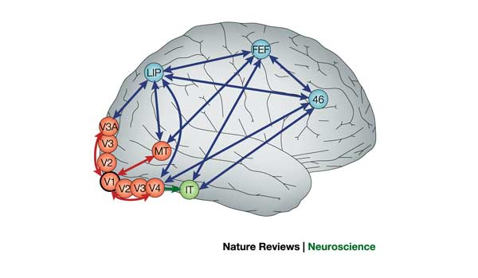
Detour: Receptive fields in V5/MT
visual
cortex
cells in visual cortex MT/V5
respond to motion stimuli

Slide 5
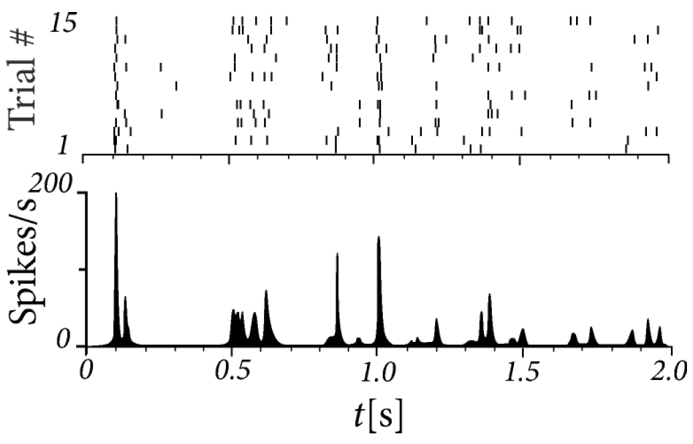
Neuronal Dynamics – 7.1 Variability in vivo
15 repetitions of the same random dot motion pattern
adapted from Bair and Koch 1996;
data from Newsome 1989

Slide 6

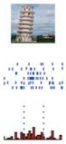
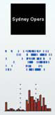
Human Hippocampus
Neuronal Dynamics – 7.1 Variability in vivo
Quiroga, Reddy,
Kreiman, Koch,
and Fried (2005).
Nature, 435:1102-1107.
Sidney opera
Sidney opera
Sidney opera

Slide 7
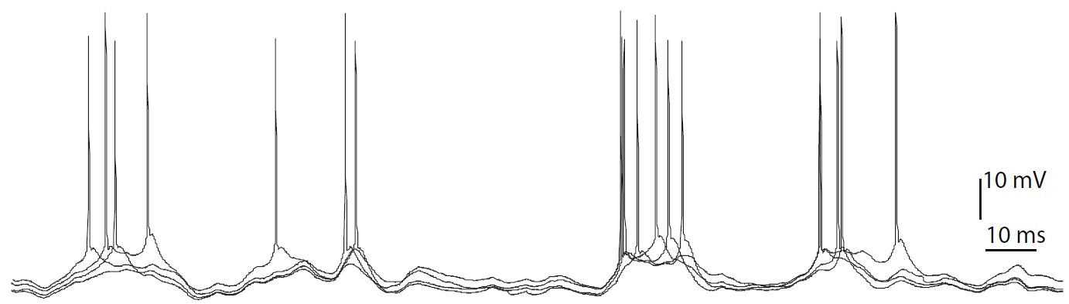
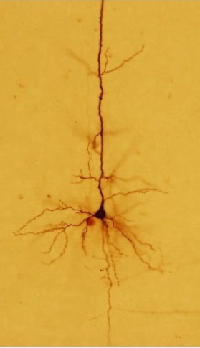
Neuronal Dynamics – 7.1 Variability in vitro
4 repetitions of the same time-dependent stimulus,
brain slice
I(t)

Slide 8
Neuronal Dynamics – 7.1 Variability
Fluctuations
of membrane potential
of spike times
In vivo data
→ looks ‘noisy’
In vitro data
→ fluctuations
fluctuations=noise?
relevance for coding?
source of fluctuations?
model of fluctuations?
Notes:
Spike timing is not reliable. The neuron models we have discussed in the first two weeks were deterministic models. If you repeat the same stimulus, they respond the same. In the brain, we find fluctuations, fluctuating membrane potentials, fluctuating spike times.
So the question arises, what's the meaning of these spikes? What does that mean for information transmission? How can neuron encode information in the presence of these fluctuations? Are these fluctuations noise? Can we model these fluctuations?

Slide 9
Week 7 – part 2 : Sources of Variability
7.1 Variability of spike trains
- experiments
7.2 Sources of Variability?
- Is variability equal to noise?
7.3 Three definitions of Rate code
- Poisson Model
7.4 Stochastic spike arrival
- Membrane potential fluctuations
7.5. Stochastic spike firing
- stochastic integrate-and-fire
Biological Modeling of Neural Networks
Week 7 – Variability and Noise:
The question of the neural code
Wulfram Gerstner
EPFL, Lausanne, Switzerland

Slide 10
Neuronal Dynamics – 7.2. Sources of Variability
- Intrinsic noise (ion channels)
Finite number of channels
Finite temperature
Na⁺
K⁺
Notes:
One potential source is that there's intrinsic noise in each neuron.
At finite temperature with a finite number of channels, we expect some stochastic effects.

Slide 11
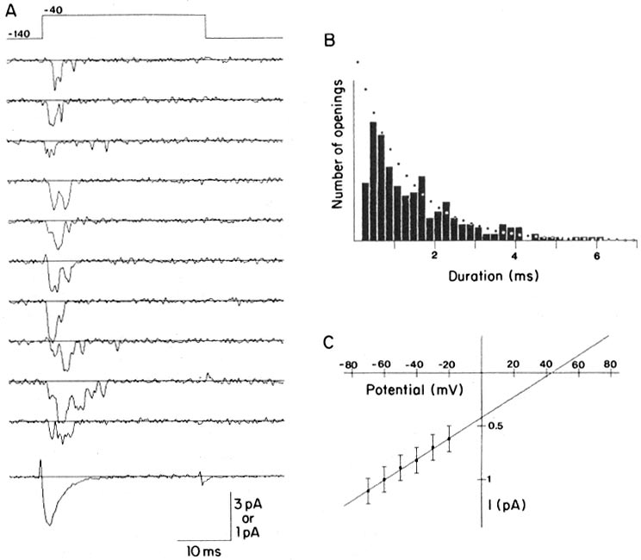
Review from 2.5 Ion channels
Na⁺
stochastic opening and closing
K⁺
Steps:
Different number
of channels
Ca²⁺
Ions/proteins
Na+ channel from rat heart (Patlak and Ortiz 1985)
A traces from a patch containing several channels.
Bottom: average gives current time course.
B. Opening times of single channel events

Slide 12
Neuronal Dynamics – 7.2. Sources of Variability
- Intrinsic noise (ion channels)
Finite number of channels
Finite temperature
Na⁺
K⁺
Network noise (background activity)
Spike arrival from other neurons
Beyond control of experimentalist
Check intrinisic noise by removing the network

Slide 13
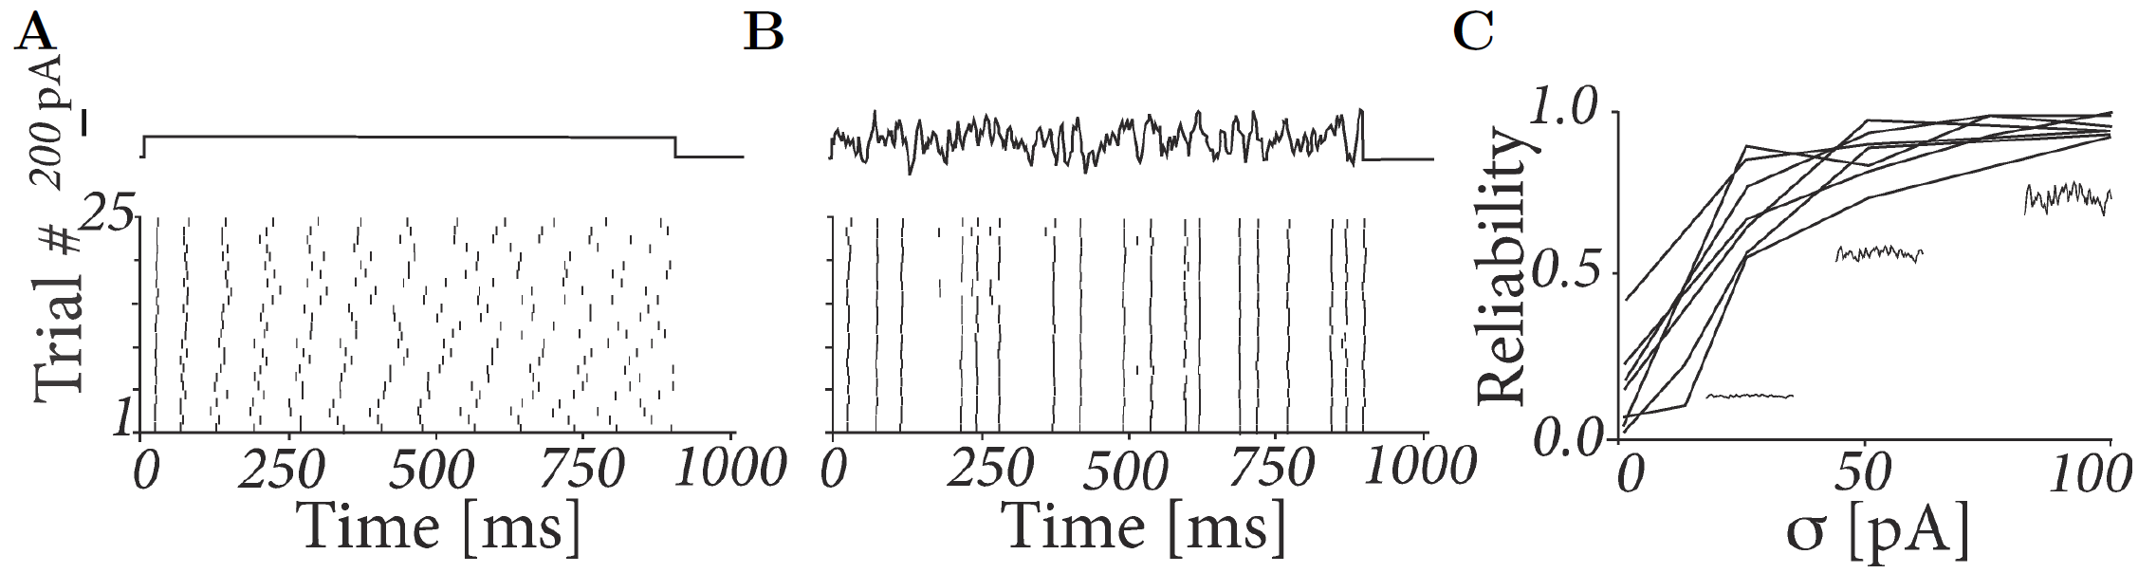
Neuronal Dynamics – 7.2 Variability in vitro
neurons are fairly reliable
I(t)
Image adapted from
Mainen&Sejnowski 1995
Notes:
Suppose we inject a step current into a single neuron. Then you see that the first spike is very reliable, in all the 25 trials shown here. However, later spikes are not reliable at all.
On the other hand, if you inject a strongly fluctuating current into the same neuron, then you see that all spikes occur fairly reliably.
So if you increase the size of the fluctuations, so the size of the fluctuations is sigma. If you increase sigma, then the reliability increases as well. And already for fairly small amount of fluctuations, the neuron is quite reliable.

Slide 14
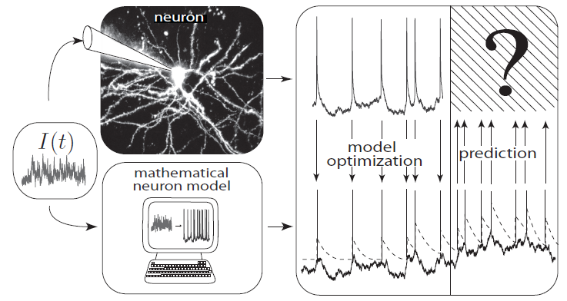
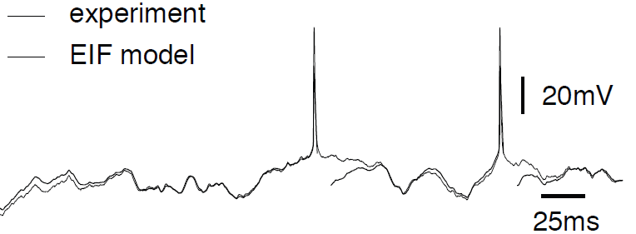
REVIEW from 1.5: How good are integrate-and-fire models?
Badel et al., 2008
Aims: - predict spike initiation times
- predict subthreshold voltage
only possible, because
neurons are fairly reliable

Slide 15
Neuronal Dynamics – 7.2. Sources of Variability
- Intrinsic noise (ion channels)
Finite number of channels
Finite temperature
Na⁺
small contribution!
K⁺
Network noise (background activity)
Spike arrival from other neurons
Beyond control of experimentalist
Check network noise by simulation!
Notes:
Thus, we may conclude that the intrinsic noise plays only a small contribution in the case that the neuron is stimulated with a fluctuating current. Now, the fluctuating current represents what the neuron is expected to see when it's embedded in the brain network. And neuron inside the brain is not going to be stimulated naturally by a step current, but rather, by some kind of fluctuating current, or more precisely, a fluctuating conductance.

Slide 16
Neuronal Dynamics – 7.2 Sources of Variability
The Brain: a highly connected system
Brain
High connectivity:
systematic, organized;
but seemingly random in local populations
Distributed architecture
10
10 neurons
4
10 connections/neurons
Notes:
There are connection patterns. Different areas across the brain are more strongly connected to each other than other areas.
However, locally, the connectivity looks more or less random.

Slide 17
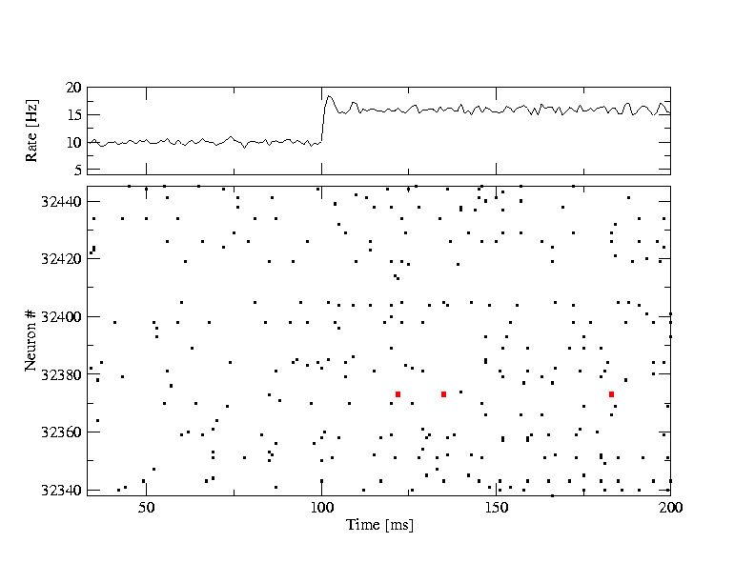
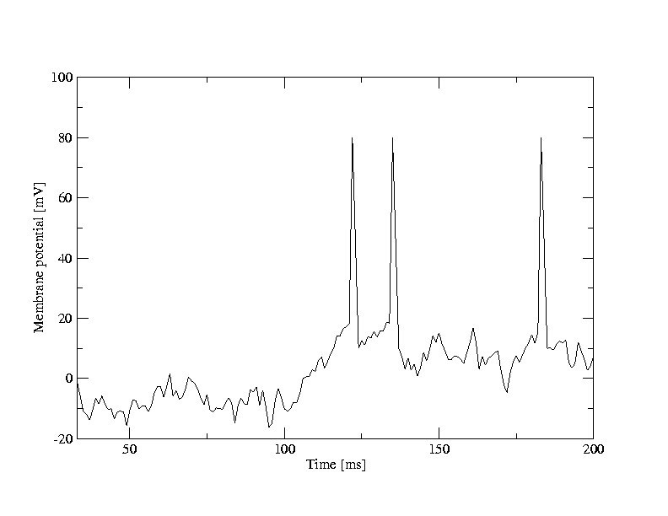
Random firing in a population of LIF neurons
A [Hz]
10
32440
Neuron #
input
-low rate
-high rate
32340
time [ms]
200
50
100
Brunel, J. Comput. Neurosc. 2000
Mayor and Gerstner, Phys. Rev E. 2005
Vogels et al., 2005
Network of deterministic
leaky integrate-and-fire:
‘fluctuations’
Population
- 50 000 neurons
- 20 percent inhibitory
- randomly connected
Notes:
The activity pattern, this spike pattern, looks more or less random. Now, this population is not isolated. It will receive spike input from other populations.
And the spike input will change at some point. And the inputs, the spike arrivals, the rate of spike arrivals to this population of neurons changes. And what you see is that the neurons emit more spikes, but it's still a random pattern.

Slide 18
Random firing in a population of LIF neurons
A [Hz]
10
32440
Neuron #
input
-low rate
-high rate
32340
time [ms]
200
50
100
100
Neuron # 32374
u [mV]
Population
- 50 000 neurons
- 20 percent inhibitory
- randomly connected
0
50
100
time [ms]
200
Notes:
And interestingly, a deterministic network of leaky integrate-and-fire neurons with random connectivity can reproduce the fluctuations of membrane potentials and the broad inter-spike interval distributions that experimentalists have observed in vivo.

Slide 19
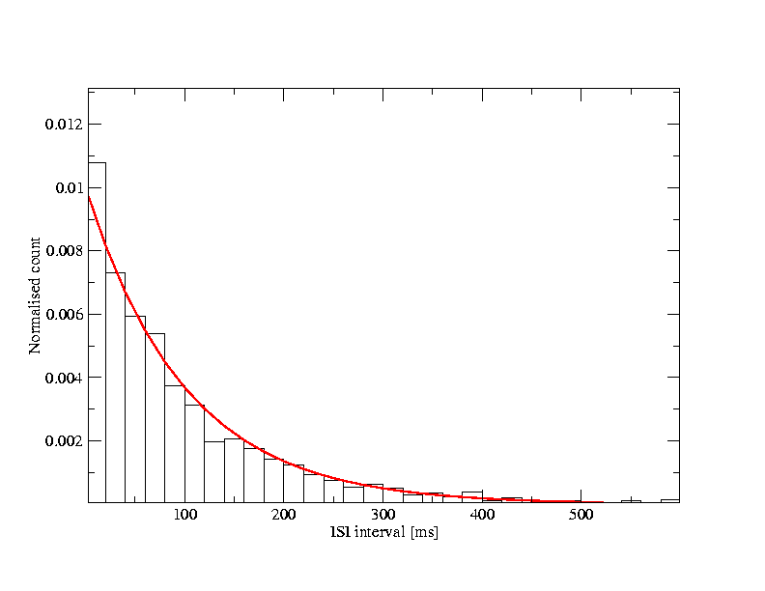
Neuronal Dynamics – 7.2. Interspike interval distribution
- Variability of interspike intervals (ISI)
here in simulations,
but also in vivo
100
u [mV]
ISI
ISI distribution
0
100
100
t [ms]
500
50
100
time [ms]
200
Variability of spike trains:
broad ISI distribution
Brunel,
J. Comput. Neurosc. 2000
Mayor and Gerstner,
Phys. Rev E. 2005
Vogels and Abbott,
J. Neuroscience, 2005

Slide 20
Neuronal Dynamics – 7.2. Sources of Variability
- Intrinsic noise (ion channels)
In vivo data
→ looks ‘noisy’
In vitro data
→small fluctuations
→nearly deterministic
Na⁺
small contribution!
K⁺
Network noise
big contribution!

Slide 21
Neuronal Dynamics – Quiz 7.1.
A- Spike timing in vitro and in vivo
[ ] Reliability of spike timing can be assessed by repeating several times the same stimulus
[ ] Spike timing in vitro is more reliable under injection of constant current than with fluctuating current
[ ] Spike timing in vitro is more reliable than spike timing in vivo
B – Interspike Interval Distribution (ISI)
[ ] An isolated deterministic leaky integrate-and-fire neuron driven by a constant current can have a broad ISI
[ ] A deterministic leaky integrate-and-fire neuron embedded into a randomly connected network of integrate-and-fire neurons can have a broad ISI
[ ] A deterministic Hodgkin-Huxley model as in week 2 embedded into a randomly connected network of Hodgkin-Huxley neurons can have a broad ISI

Slide 22
Week 7 – part 3 : Poisson Model – rate coding
7.1 Variability of spike trains
- experiments
7.2 Sources of Variability?
- Is variability equal to noise?
7.3 Poisson Model
- Poisson Model
- 3 definitions of rate coding
7.4 Stochastic spike arrival
- Membrane potential fluctuations
7.5. Stochastic spike firing
- stochastic integrate-and-fire
Biological Modeling of Neural Networks
Week 7 – Variability and Noise:
The question of the neural code
Wulfram Gerstner
EPFL, Lausanne, Switzerland

Slide 23
Neuronal Dynamics – 7.3. Three definitions of Rate Codes
3 definitions
Temporal averaging
Averaging across repetitions
Population averaging (‘spatial’ averaging)

Slide 24
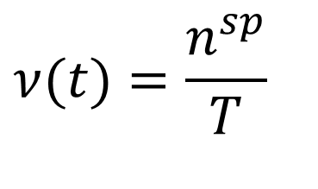
Neuronal Dynamics – 7.3. Rate codes: spike count
Variability of spike timing
trial 1
rate as a (normalized) spike count:
$$ν(t)=\frac{n^{sp}}{T}$$
single neuron/single trial:
temporal average
T=1s
Brain
stim

Slide 25
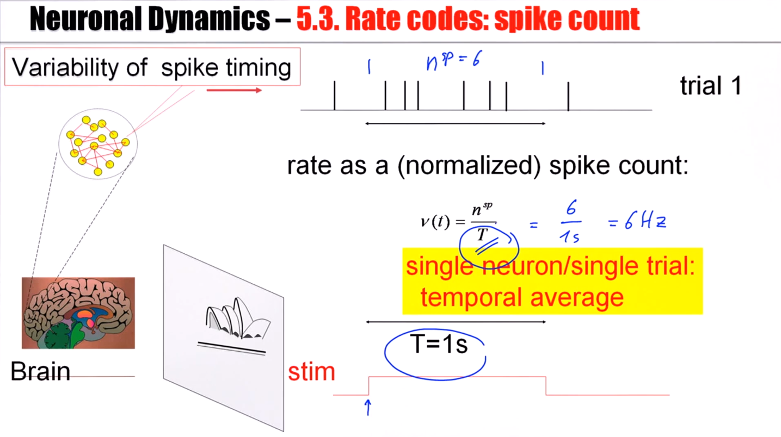
Notes:
In order to evaluate the rate, you just have to measure a single neuron for a single trial, but we have to average over time. You measurement interval has to be sufficiently long.

Slide 26
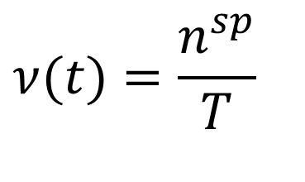
Neuronal Dynamics – 7.3. Rate codes: spike count
single neuron/single trial:
temporal average
$$ν(t)=\frac{n^{sp}}{T}$$
Variability of interspike intervals (ISI)
measure regularity
100
u [mV]
ISI
ISI distribution
0
100
100
t [ms]
500
50
100
time [ms]
200
Notes:
Now in this case, we have nine spikes in our measuring interval T. Now a different neuron may also have nine spikes, but the spike train in this case is much more regular. In order to distinguish between the first case and the second one, it’s important to look at the distribution of inter-spike intervals. So that inters-pike interval distribution measures the variability of the firing where it's a measure of the regularity.

Slide 27
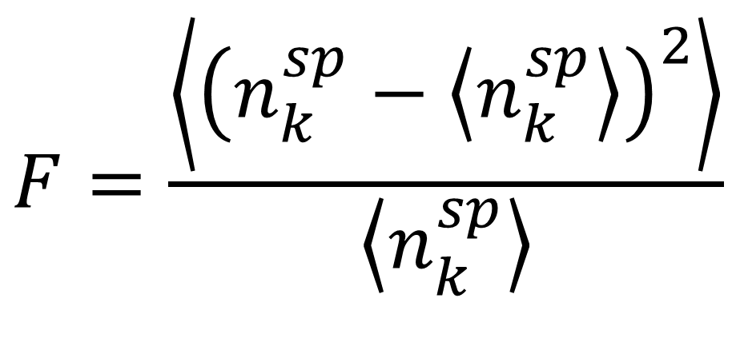
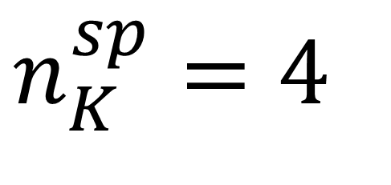
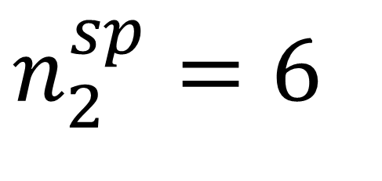
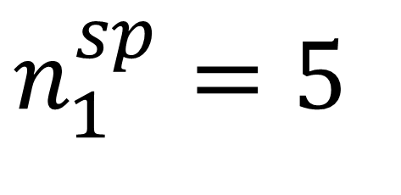
Neuronal Dynamics – 7.3. Spike count: FANO factor
trial 1
$$n_{1}^{sp}=5$$
trial 2
$$n_{2}^{sp}=6$$
$$n_{K}^{sp}=4$$
trial K
Fano factor
T
$$F=\frac{\left\langle {\left(n_{k}^{sp}−\left\langle n_{k}^{sp}\right\rangle \right)}^{2}\right\rangle }{\left\langle n_{k}^{sp}\right\rangle }$$
Brain
stim
Notes:
Fano factor measures repeatability across repetitions.

Slide 28
Neuronal Dynamics – 7.3. Three definitions of Rate Codes
3 definitions
Temporal averaging (spike count)
ISI distribution (regularity of spike train)
Fano factor (repeatability across repetitions)
Averaging across repetitions
Population averaging (‘spatial’ averaging)
Problem: slow!!!
Notes:
While this is a good measure to analyze experimental data, it's not a code that's used by the brain(neuron).

Slide 29
Neuronal Dynamics – 7.3. Three definitions of Rate Codes
3 definitions
Temporal averaging
Averaging across repetitions
Population averaging
Problem: slow!!!

Slide 30
Neuronal Dynamics – 7.3. Rate codes: PSTH
Variability of spike timing
trial 1
trial 2
trial K
Brain
stim

Slide 31
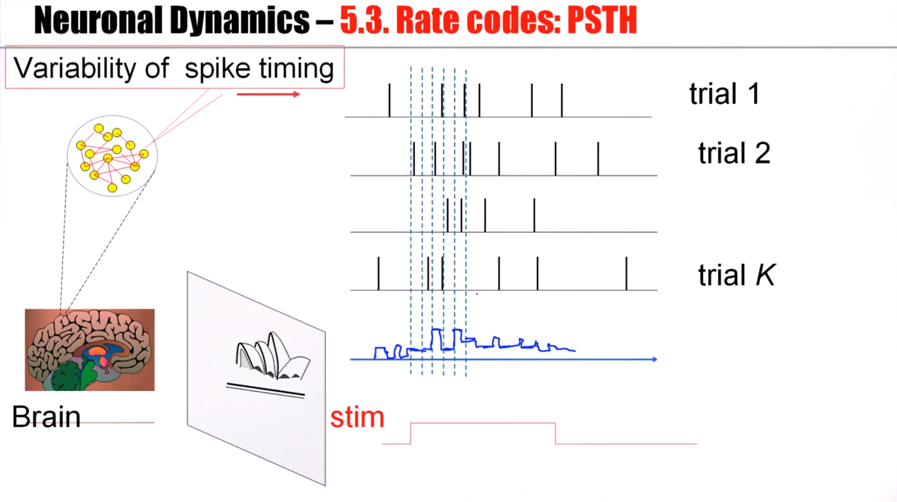
Notes:
But now, instead of just counting the total number of spikes, we define short time windows.
PSTH: peristimulus time histogram.

Slide 32
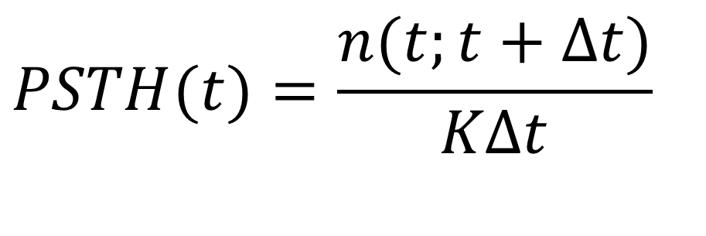
Neuronal Dynamics – 7.3. Rate codes: PSTH
Averaging across repetitions
single neuron/many trials:
average across trials
t
K repetitions
$$PSTH(t)=\frac{n(t;t+Δt)}{KΔt}$$
Stim(t)
PSTH(t)
K=50 trials
Notes:
Formally, this means we count the number of spikes in a short time in the delta T across K repetitions.
It's a rate measure, but now with a temporal resolution defined by delta T.

Slide 33
Neuronal Dynamics – 7.3. Three definitions of Rate Codes
3 definitions
Temporal averaging
Averaging across repetitions
Population averaging
Problem: not useful for animal!!!
Notes:
And now, the fly comes by, and the frog says to the fly, well, please fly again another 50 time so that I can average so that I can finally catch you.
So that's not going to happen.

Slide 34
Neuronal Dynamics – 7.3. Rate codes: population activity
population of neurons
with similar properties
neuron 1
neuron 2
Neuron K
Brain
stim

Slide 35
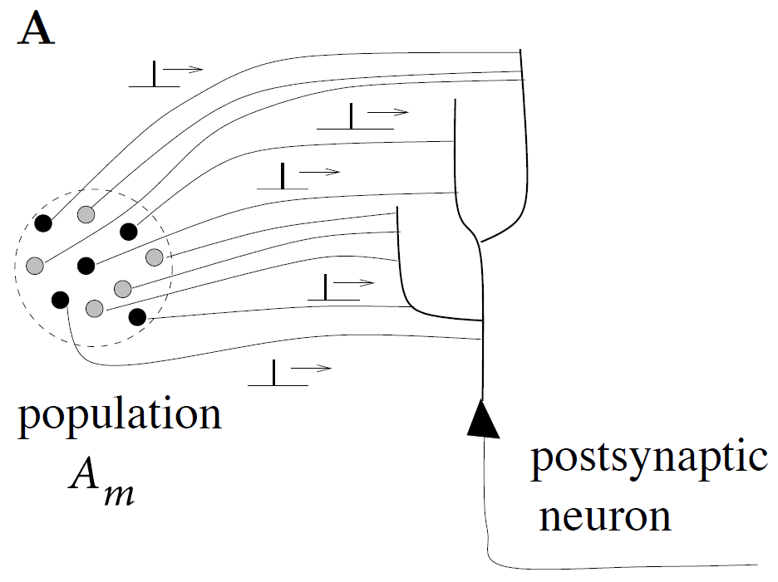
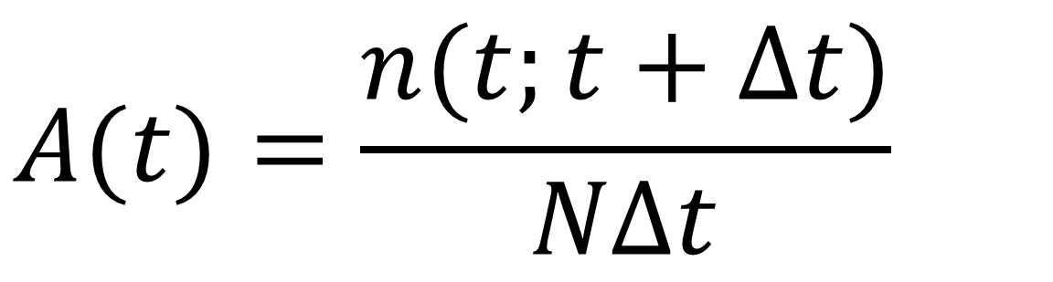
Neuronal Dynamics – 7.3. Rate codes: population activity
population activity - rate defined by population average
t
t
$$A(t)=\frac{n(t;t+Δt)}{NΔt}$$
‘natural readout’
population
activity
Notes:
In this case, the rate can be defined by a population average.
I count in a short time interval delta T, I count all the spikes across the different neurons in a population. I divide by delta T, I divide by N, the number of neurons.

Slide 36
Neuronal Dynamics – 7.3. Three definitions of Rate codes
Three averaging methods
over time
over repetitions
over population (space)
Too slow
for animal!!!
single neuron
single neuron
Not possible
for animal!!!
many neurons
‘natural’

Slide 37
Neuronal Dynamics – Quiz 7.3.
Rate codes. Suppose that in some brain area we have a group of 500 neurons. All neurons have identical parameters and they all receive the same input. Input is given by sensory stimulation and passes through 2 preliminary neuronal processing steps before it arrives at our group of 500 neurons. Within the group, neurons are not connected to each other. Imagine the brain as a model network containing 100 000 nonlinear integrate-and-fire neurons, so that we know exactly how each neuron functions.
Experimentalist A makes a measurement in a single trial on all 500 neurons using a multi-electrode array, during a period of sensory stimulation.
Experimentalist B picks an arbitrary single neuron and repeats the same sensory stimulation 500 times (with long pauses in between, say one per day).
Experimentalist C repeats the same sensory stimulation 500 times (1 per day), but every day he picks a random neuron (amongst the 500 neurons).
All three determine the time-dependent firing rate.
[ ] A and B and C are expected to find the same result.
[ ] A and B are expected to find the same result, but that of C is expected to be different.
[ ] B and C are expected to find the same result, but that of A is expected to be different.
[ ] None of the above three options is correct.
Start at 10:50,
Discussion at 10:55
Notes:
The 5 minutes of discussion were really great, because students did have different opinions and arguments.

Slide 38
Week 7 – part 3 : Poisson Model – rate coding
7.1 Variability of spike trains
- experiments
7.2 Sources of Variability?
- Is variability equal to noise?
7.3 Poisson Model
- Poisson Model
- 3 definitions of rate coding
7.4 Stochastic spike arrival
- Membrane potential fluctuations
7.5. Stochastic spike firing
- stochastic integrate-and-fire
Biological Modeling of Neural Networks
Week 7 – Variability and Noise:
The question of the neural code
Wulfram Gerstner
EPFL, Lausanne, Switzerland

Slide 39
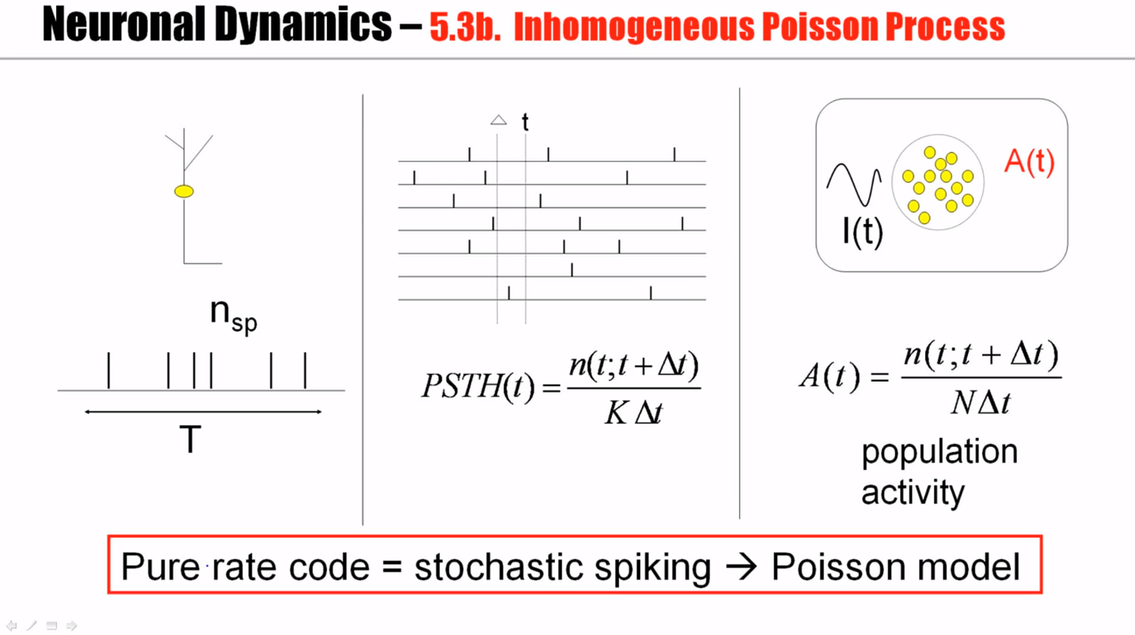

Slide 40
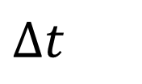
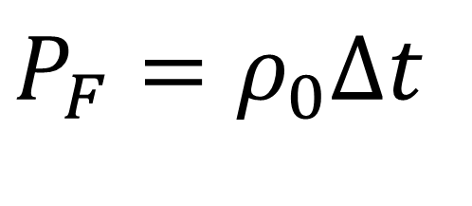
Neuronal Dynamics – 7.3 Poisson Model
Homogeneous Poisson model: constant rate
Blackboard:
Poisson model
$$Δt$$
Probability of finding a spike
$$P_{F}=ρ_{0}Δt$$
stochastic spiking → Poisson model
Notes:
Homogeneous Poisson process: We assume that during the whole period, big T, the neuron and fires at a constant rate.
This is expressed by this relation that the probability is proportional to delta t for very small delta t.

Slide 41
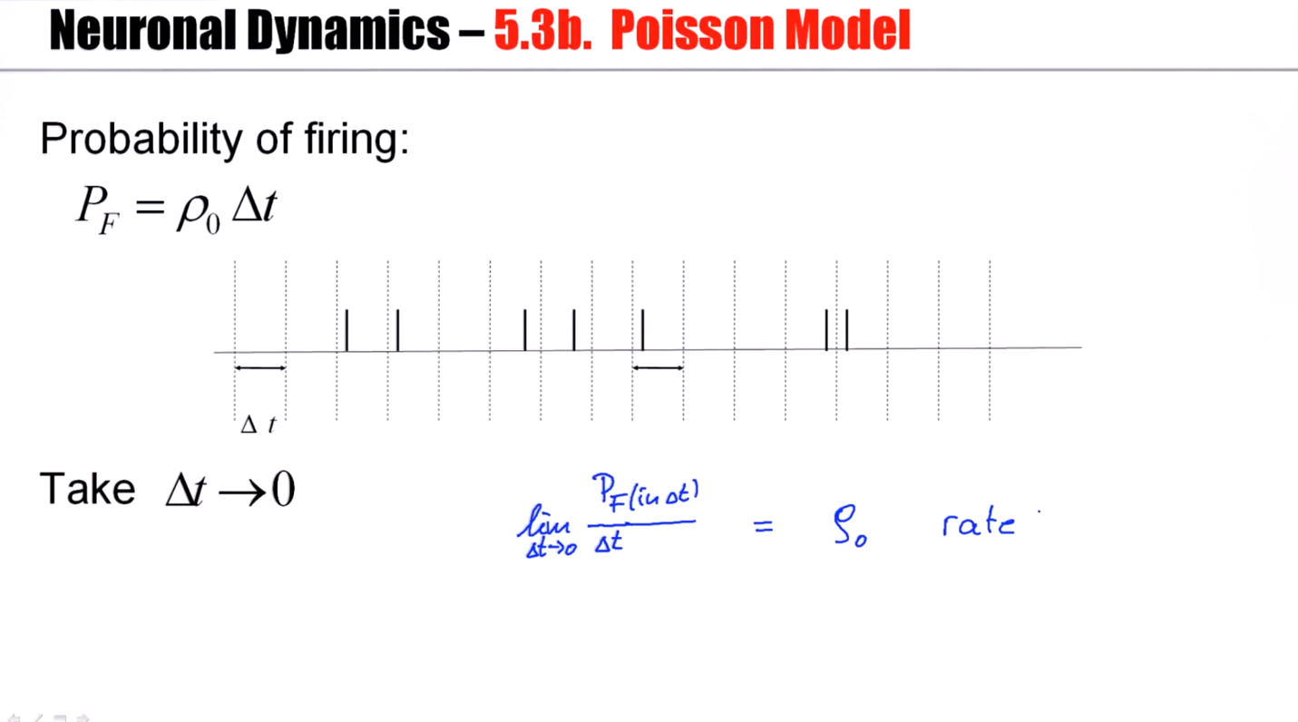

Slide 42
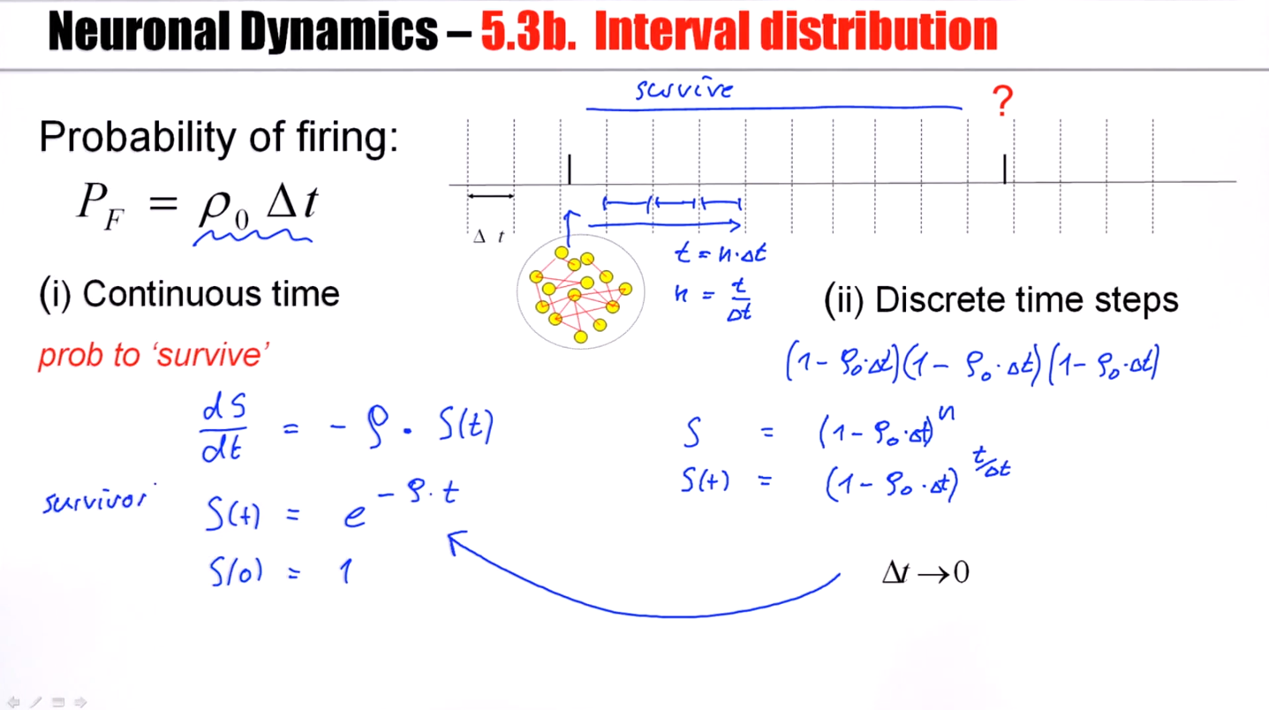
Notes:
The group that still survives will decay exponentially.

Slide 43
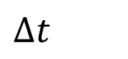
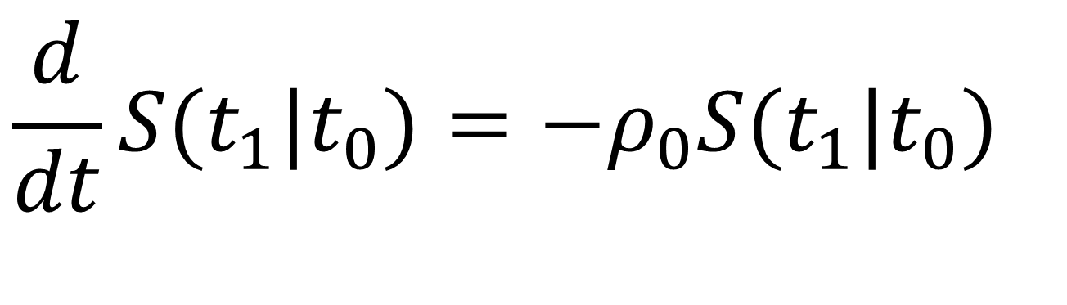
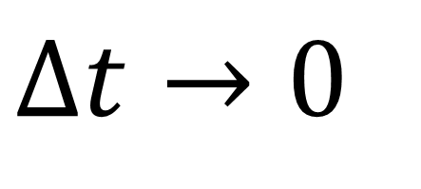
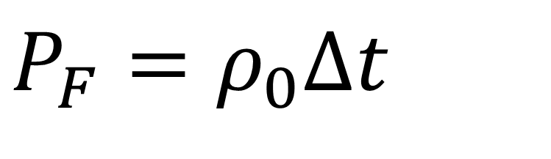
Neuronal Dynamics – 7.3 Interval distribution
?
Probability of firing:
$$P_{F}=ρ_{0}Δt$$
$$Δt$$
(i) Continuous time
(ii) Discrete time steps
prob to ‘survive’
Blackboard:
Poisson model
$$Δt→0$$
$$\frac{d}{dt}S(t_{1}|t_{0})=−ρ_{0}S(t_{1}|t_{0})$$

Slide 44
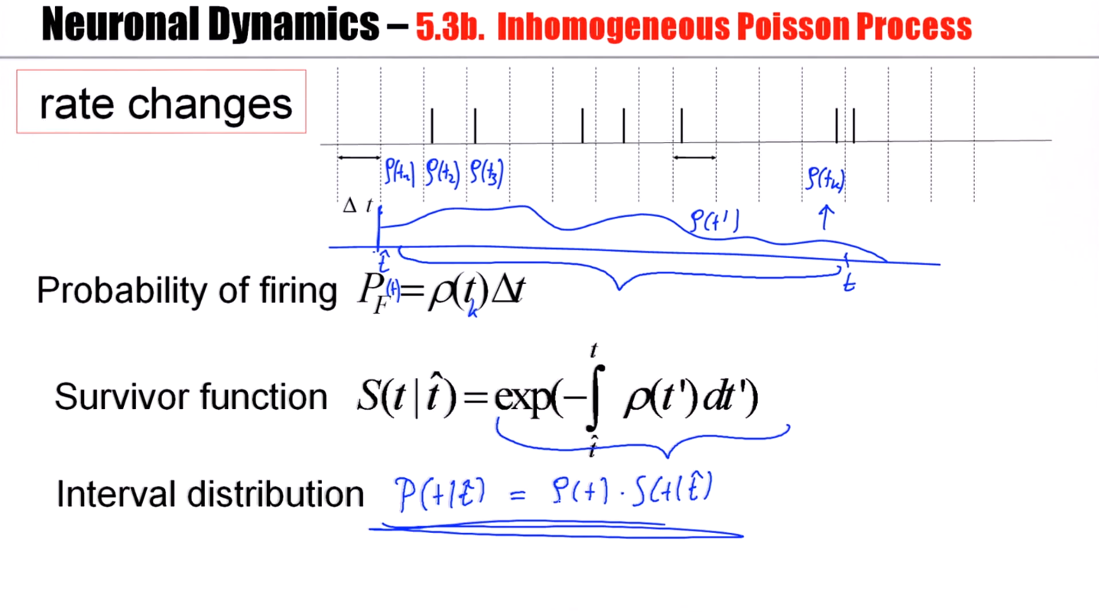
Notes:
For isi distribution, it means the neuron has to survive from t hat to t without firing. So I can take the expression I just calculated. But then it actually has to fire at time t, and the instantaneous rate of firing at time t is rho of t.

Slide 45
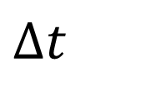
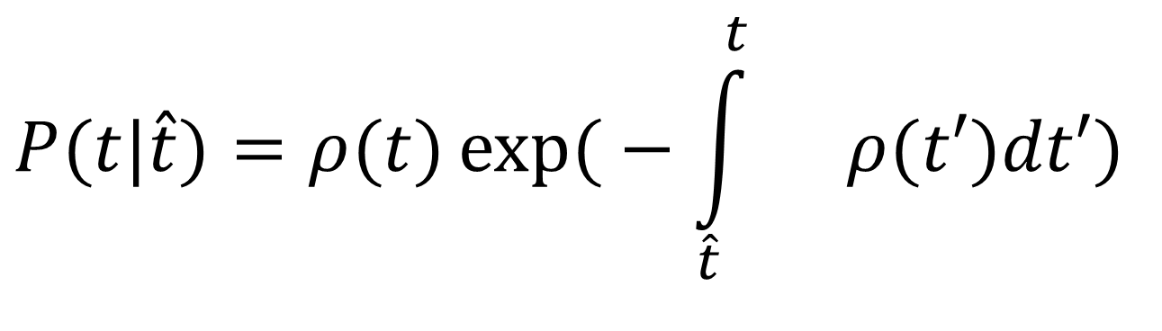
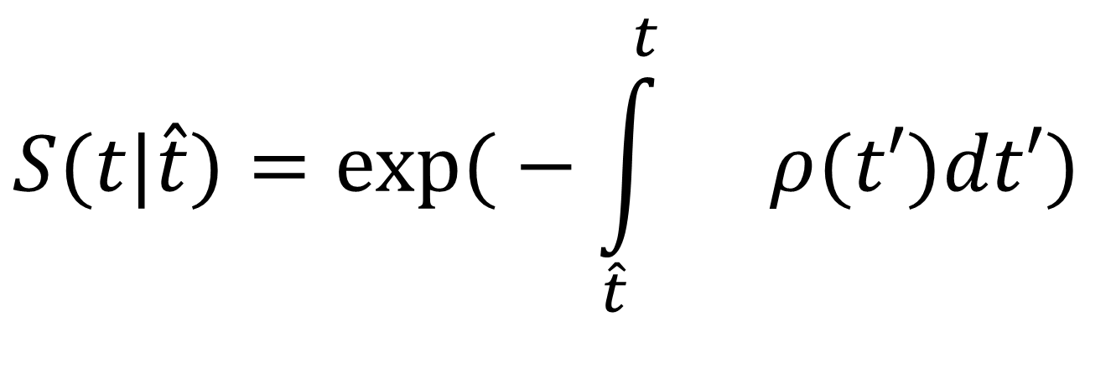
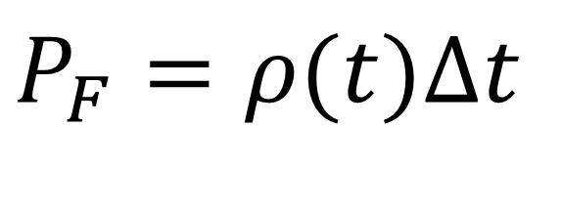
Neuronal Dynamics – 7.3 Inhomogeneous Poisson Process
rate changes
$$Δt$$
$$P_{F}=ρ(t)Δt$$
Probability of firing
$$S(t|\hat{t})=\exp{(}−\int_{\hat{t}}^{t}{}ρ(t′)dt′)$$
Survivor function
Interval distribution
$$P(t|\hat{t})=ρ(t)\exp{(}−\int_{\hat{t}}^{t}{}ρ(t′)dt′)$$

Slide 46
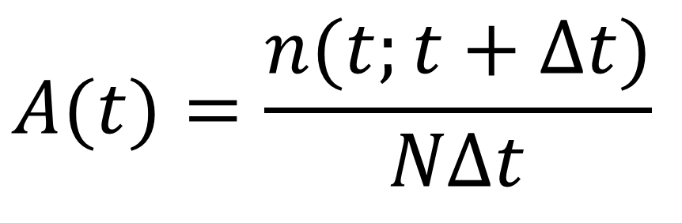
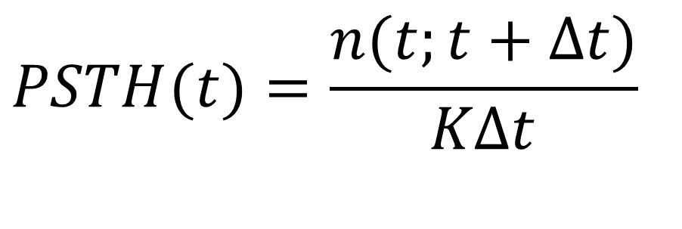
Neuronal Dynamics – 7.3 Inhomogeneous Poisson Process
t
A(t)
I(t)
n_{sp}
$$PSTH(t)=\frac{n(t;t+Δt)}{KΔt}$$
$$A(t)=\frac{n(t;t+Δt)}{NΔt}$$
T
population
activity
inhomogeneous Poisson model consistent with rate coding

Slide 47
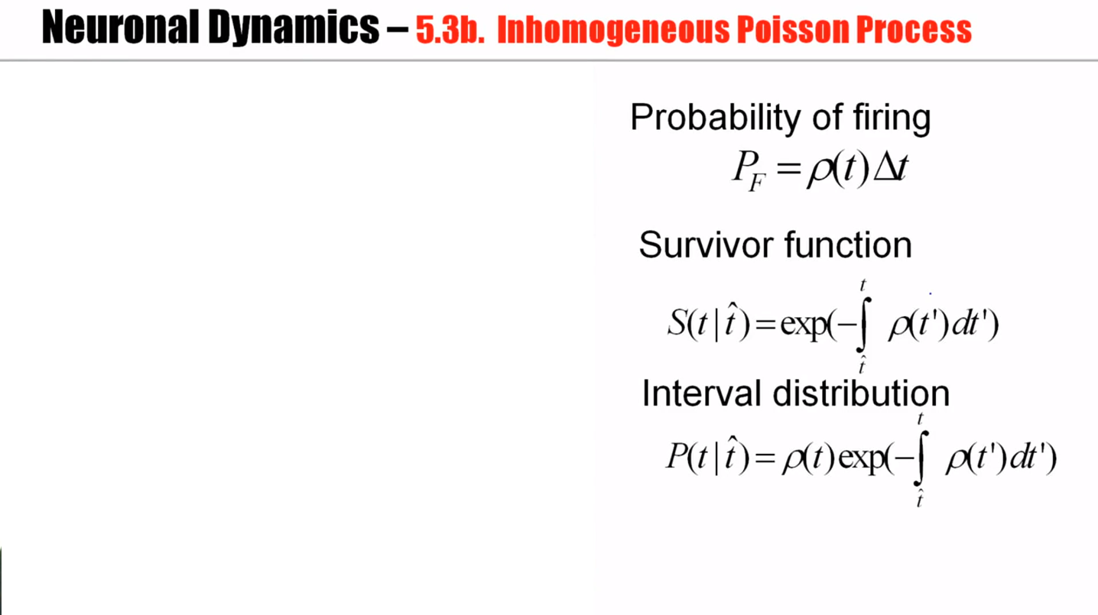
Notes:
In a Poisson model firing in step one, it's independent to firing in step two. A real neuron, if it fires a spike, it will have at dead time. It will be refractory. It's less likely to fire immediately afterwards. That's not captured by a Poisson model, neither by the homogeneous nor by the inhomogeneous Poisson process. Nevertheless, the Poisson model is an important reference model used widely in experimental and theoretical neuroscience.

Slide 48
Neuronal Dynamics – Quiz 7.2.
A Homogeneous Poisson Process:
A spike train is generated by a homogeneous Poisson process with rate 25Hz with time steps of 0.1ms.
[ ] The most likely interspike interval is 25ms.
[ ] The most likely interspike interval is 40 ms.
[ ] The most likely interspike interval is 0.1ms
[ ] We can’t say.
B Inhomogeneous Poisson Process:
A spike train is generated by an inhomogeneous Poisson process with a rate that oscillates periodically (sine wave) between 0 and 50Hz (mean 25Hz). A first spike has been fired at a time when the rate was at its maximum. Time steps are 0.1ms.
[ ] The most likely interspike interval is 25ms.
[ ] The most likely interspike interval is 40 ms.
[ ] The most likely interspike interval is 0.1ms.
[ ] We can’t say.
Notes:
This worked very well. Students were REALLY suprised that the most likely interval is the shortest one (in both cases)

Slide 49
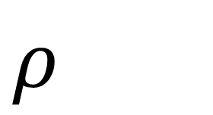
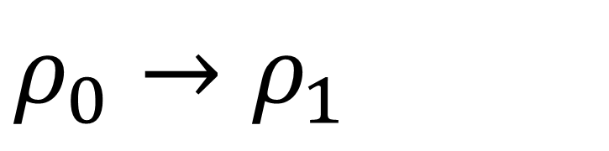
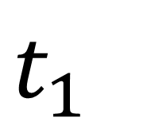
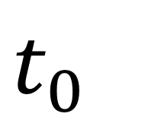
Exercise 1.1 and 1.2: Poisson neuron
Start 9:50 - Next lecture at 10:15
s
Poisson rate
$$ρ$$
stimulus
$$t_{0}$$
$$t_{1}$$
1.1. - Probability of NOT firing during time t?
1.2. - Interval distribution p(s)?
1.3.- How can we detect if rate switches from
$$ρ_{0}→ρ_{1}$$
(1.4 at home:)
-2 neurons fire stochastically (Poisson) at 20Hz.
Percentage of spikes that coincide within +/-2 ms?)

Slide 50
Neuronal Dynamics: Computational Neuroscience of Single Neurons
Week 7 – part 4 :Stochastic spike arrival
7.1 Variability of spike trains
- experiments
7.2 Sources of Variability?
- Is variability equal to noise?
7.3 Three definitions of Rate code
- Poisson Model
7.4 Stochastic spike arrival
- Membrane potential fluctuations
7.5. Stochastic spike firing
- stochastic integrate-and-fire
Week 7 – Variability and Noise:
The question of the neural code
Wulfram Gerstner
EPFL, Lausanne, Switzerland

Slide 51
Neuronal Dynamics – 7.4 Variability in vivo
Spontaneous activity in vivo
Variability
of membrane potential?
awake mouse, freely whisking,
Crochet et al., 2011
Notes:
We now turn to our first model that should allow to explain that observed fluctuations of the membrane potential.

Slide 52
Random firing in a population of LIF neurons
A [Hz]
10
32440
Neuron #
input
-low rate
-high rate
32340
time [ms]
200
50
100
100
Neuron # 32374
u [mV]
Population
- 50 000 neurons
- 20 percent inhibitory
- randomly connected
0
50
100
time [ms]
200
Notes:
We have seen that fluctuating membrane potentials can be observed randomly connected network of leaky integrate-and-fire neurons.

Slide 53
Neuronal Dynamics – 7.4 Membrane potential fluctuations
from neuron’s point
of view:
stochastic spike arrival
Pull out one neuron
‘Network noise’
big contribution!

Slide 54
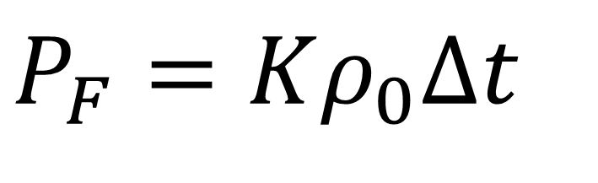
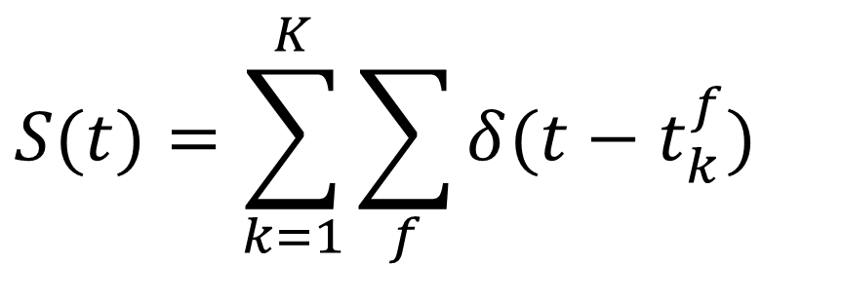
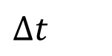

Neuronal Dynamics – 7.4. Stochastic Spike Arrival
Blackboard
now!
Total spike train of K presynaptic neurons
$$Δt$$
spike train
Pull out one neuron
Probability of spike arrival:
$$P_{F}=Kρ_{0}Δt$$
Take
$$Δt→0$$
expectation
$$S(t)=\sum_{k=1}^{K}{\sum_{f}{δ(t−t_{k}^{f}}})$$

Slide 55


Slide 56

Notes:
Stochastic are the spike times.

Slide 57







Neuronal Dynamics – 7.5. Fluctuation of current/potential
Synaptic current pulses of shape α
$$RI^{syn}(t)=\sum_{k}{w_{k}\sum_{f}{}α(t−t_{k}^{f}})$$
EPSC
I
Passive membrane
$$RI(t)$$
$$I_{0}$$
$$τ^{}\frac{d}{dt}u=−(u−u_{rest})+RI^{syn}(t)$$
$$I^{syn}(t)=I_{0}+I^{fluct}(t)$$
→ Fluctuating potential
I(t)
$$μ$$
$$σ$$
Fluctuating input current
Notes:
And so in that sense, a neuron embedded in the network is very similar to an isolated neuron driven by a fluctuating current with a certain mean, mu, and a certain variance of the fluctuations, called sigma.

Slide 58


Slide 59








Neuronal Dynamics – 7.4. Calculating the mean
$$RI^{syn}(t)=\sum_{k}{w_{k}\sum_{f}{}α(t−t_{k}^{f}})$$
$$Δt$$
$$I^{syn}(t)=\frac{1}{R}\sum_{k}{w_{k}\sum_{f}{\int{dt′}α(t−t′)}δ(t′−t_{k}^{f}})$$
$$x(t)=\sum_{f}{\int{dt′}f(t−t′)}δ(t′−t_{k}^{f})$$
mean: assume Poisson process
$$I_{0}=\left\langle I^{syn}(t)\right\rangle =\frac{1}{R}\sum_{k}{w_{k}\int{dt′}α(t−t′)\left\langle \sum_{f}{}δ(t′−t_{k}^{f})\right\rangle }$$
$$\left\langle x(t)\right\rangle =\int{dt′}f(t−t′)\left\langle \sum_{f}{}δ(t′−t_{k}^{f})\right\rangle$$
use for exercise
$$\left\langle x(t)\right\rangle =\int{dt′}f(t−t′)ρ(t′)$$
$$I_{0}=\frac{1}{R}\sum_{k}{w_{k}\int{dt′}α(t−t′)ν_{k}}$$
rate of inhomogeneous
Poisson process
Notes:
Suppose I have some arbitrary variable x of t, which can be described as a filtering process, and some point-like events-- pulses, for example, a spike train. Then the average is just the average of the pulses integrated with that filter.

Slide 60


Neuronal Dynamics – Exercise 2.1 NOW
$$Δt$$
Passive membrane
$$τ^{}\frac{d}{dt}u=−(u−u_{rest})+RI^{syn}(t)$$
$$u(t)=\sum_{f}{\int{ds}f(s)}δ(t−t_{k}^{f}−s)$$
A leaky integrate-and-fire neuron without threshold (=passive membrane) receives stochastic spike arrival, described as a homogeneous Poisson process.
Calculate the mean membrane potential. To do so, use the above formula.
Start at 11:35,
Discussion at 11:48

Slide 61
Biological Modeling and Neural Networks
Week 7 – part 5 : Stochastic spike firing in integrate-and-fire models
7.1 Variability of spike trains
7.2 Sources of Variability?
- Is variability equal to noise?
7.3 Three definitions of Rate cod
7.4 Stochastic spike arrival
- Membrane potential: mean value
7.5. Stochastic spike firin
7.6 Subthreshold and superth.
7.7. Calculate fluctuations
- autocorrelation of membrane pot.
- standard deviation of membr. Pot.
- autocorrelation of Poisson
Week 7 – Variability and Noise:
The question of the neural code
Wulfram Gerstner
EPFL, Lausanne, Switzerland

Slide 62
Neuronal Dynamics – 7.7 Variability in vivo
Spontaneous activity in vivo
Variability
of membrane potential?
awake mouse, freely whisking,
Crochet et al., 2011
Subthreshold regime

Slide 63
Neuronal Dynamics – 7.7. Fluctuations of potential
Synaptic current pulses of shape α
$$RI^{syn}(t)=\sum_{k}{w_{k}\sum_{f}{}α(t−t_{k}^{f}})$$
EPSC
I
Passive membrane
$$RI(t)$$
$$I_{0}$$
$$τ^{}\frac{d}{dt}u=−(u−u_{rest})+RI^{syn}(t)$$
$$I^{syn}(t)=I_{0}+I^{fluct}(t)$$
→ Fluctuating potential
I(t)
$$μ$$
$$σ$$
Fluctuating input current
Notes:
Can we say something about the mean of this fluctuating potential?

Slide 64



Neuronal Dynamics – 7.7. Fluctuations of potential
$$Δu(t)$$
$${\left\langle u(t)\right\rangle }^{}$$
$$\left\langle Δu(t)Δu(t)\right\rangle =\left\langle u(t)u(t)\right\rangle −{\left\langle u(t)\right\rangle }^{2}=$$
Input: step + fluctuations

Slide 65

Notes:
x(t): spike train
The question is can I say anything about the probability that the spike here at time t is correlated with a later spike at time t double prime?

Slide 66





Neuronal Dynamics – 7.7. Calculating autocorrelations
Autocorrelation
$$Δt$$
$$x(t)=\sum_{f}{\int{dt′}f(t−t′)}δ(t′−t_{k}^{f}) \\ =\int{dt′}f(t−t′)S(t′)$$
$$\left\langle x(t)x(t′)\right\rangle =$$
Mean:
$$\left\langle x(t)\right\rangle =\int{dt′}f(t−t′)\left\langle S(t′)\right\rangle$$
$$\left\langle x(t)\right\rangle =\int{ds}f(s)ρ_{0}$$
rate of homogeneous
Poisson process
$$\left\langle x(t)x(\hat{t})\right\rangle =\int{dt′}\int{dt"}f(t−t′)f(\hat{t}−t")\left\langle S(t′)S(t")\right\rangle$$

Slide 67

Notes:
Poisson process means that the find probability in this time step n is completely independent from the probability of firing in some other time step k.

Slide 68


Neuronal Dynamics – 7.7. Autocorrelation of Poisson
math detour
now!
Probability of spike
in step n AND step k
$$Δt$$
spike train
Probability of spike in time step:
$$P_{F}=ρ_{0}Δt$$
Autocorrelation (continuous time)
$$\left\langle S(t)S(t′)\right\rangle =ρ_{0}δ(t−t′)+[ρ_{0}]^{2}$$

Slide 69


Neuronal Dynamics – 7.7. Fluctuation of potential
for a passive membrane, we can analytically predict the amplitude of membrane potential fluctuations
Passive membrane
$$u(t)=\sum_{k}{w_{k}}\sum_{f}{}ε(t′−t_{k}^{f}) \\ =\sum_{k}{w_{k}}\int{dt′}ε(t−t′)S_{k}(t′)$$
Leaky integrate-and-fire
in subthreshold regime
fluctuating potential
$$\left\langle Δu(t)Δu(t)\right\rangle =\left\langle [u(t)]^{2}\right\rangle −{\left\langle u(t)\right\rangle }^{2}$$

Slide 70

Neuronal Dynamics – 7.5. Fluctuation of potential
for a passive membrane, we can analytically predict the mean of membrane potential fluctuations
Passive membrane
$$τ^{}\frac{d}{dt}u=−(u−u_{rest})+RI^{syn}(t)$$
Passive membrane
=Leaky integrate-and-fire
without threshold
ADD THRESHOLD
→ Leaky Integrate-and-Fire

Slide 71





Neuronal Dynamics – Quiz 7.4
A linear (=passive) membrane has a potential given by
$$u(t)=\sum_{f}{\int{dt′}f(t−t′)}δ(t′−t_{k}^{f})+a$$
Suppose the neuronal dynamics are given by
$$τ^{}\frac{d}{dt}u=−(u−u_{rest})+q\sum_{f}{}δ(t−t^{f})$$
[ ] the filter f is exponential with time constant
$$τ^{}$$
$$τ^{}$$
[ ] the constant a is equal to the time constant
[ ] the constant a is equal to
$$u_{rest}$$
[ ] the amplitude of the filter f is proportional to q
[ ] the amplitude of the filter f is q

Slide 72
Biological Modeling and Neural Networks
Week 7 – part 5 : Stochastic spike firing in integrate-and-fire models
7.1 Variability of spike trains
- experiments
7.2 Sources of Variability?
- Is variability equal to noise?
7.3 Three definitions of Rate code
- Poisson Model
7.4 Stochastic spike arrival
- Membrane potential fluctuations
7.5. Stochastic spike firing
- Stochastic Integrate-and-fire
Week 7 – Variability and Noise:
The question of the neural code
Wulfram Gerstner
EPFL, Lausanne, Switzerland

Slide 73



stochastic spike arrival in I&F – interspike intervals
I
$$I_{0}$$
ISI distribution

Slide 74

Notes:
Without the noisy contribution, this neuron would never spike. The membrane potential would remain subthreshold.

Slide 75


LIF with Diffusive noise (stochastic spike arrival)
Superthreshold vs. Subthreshold regime

Slide 76

Notes:
Interestingly, if we zoom in on this subthreshold regime, it looks very similar to the in vivo data of subthreshold membrane potential fluctuations.

Slide 77
Neuronal Dynamics – 7.5. Stochastic leaky integrate-and-fire
noisy input/ diffusive noise/
stochastic spike arrival
u(t)
subthreshold regime:
- firing driven by fluctuations
- broad ISI distribution
- in vivo like
ISI distribution

Slide 78
Neuronal Dynamics week 5– References and Suggested Reading
Reading: W. Gerstner, W.M. Kistler, R. Naud and L. Paninski,
Neuronal Dynamics: from single neurons to networks and models of cognition. Ch. 7,8: Cambridge, 2014
OR W. Gerstner and W. M. Kistler, Spiking Neuron Models, Chapter 5, Cambridge, 2002
-Rieke, F., Warland, D., de Ruyter van Steveninck, R., and Bialek, W. (1996). Spikes - Exploring the neural code. MIT Press.
-Faisal, A., Selen, L., and Wolpert, D. (2008). Noise in the nervous system. Nat. Rev. Neurosci., 9:202
-Gabbiani, F. and Koch, C. (1998). Principles of spike train analysis. In Koch, C. and Segev, I., editors,
Methods in Neuronal Modeling, chapter 9, pages 312-360. MIT press, 2nd edition.
Softky, W. and Koch, C. (1993). The highly irregular firing pattern of cortical cells is inconsistent with temporal integration of random epsps. J . Neurosci., 13:334-350.
Stein, R. B. (1967). Some models of neuronal variability. Biophys. J., 7:37-68.
Siegert, A. (1951). On the first passage time probability problem. Phys. Rev., 81:617{623.
Konig, P., et al. (1996). Integrator or coincidence detector? the role of the cortical neuron revisited. Trends Neurosci, 19(4):130-137.
THE END

Slide 79
Biological Modeling and Neural Networks
Week 7 – part 5 : Stochastic spike firing in integrate-and-fire models
7.1 Variability of spike trains
- experiments
7.2 Sources of Variability?
- Is variability equal to noise?
7.3 Three definitions of Rate code
- Poisson Model
7.4 Stochastic spike arrival
- Membrane potential: mean value
7.5. Stochastic spike firing
- Integrate-and-fire
7.6 Subthreshold and superth.
7.7. Calculate fluctuations
Week 7 – Variability and Noise:
The question of the neural code
Wulfram Gerstner
EPFL, Lausanne, Switzerland

Slide 80


Neuronal Dynamics – 7.4. Fluctuation of current/potential
fluctuating input current
I(t)
$$μ$$
$$σ$$
Random spike arrival
fluctuating potential

Slide 81
Neuronal Dynamics – 5.4b. Fluctuation of potential
Stochastic spike arrival:
for a passive membrane, we can analytically predict the amplitude of membrane potential fluctuations
Passive membrane
$$u(t)=\sum_{k}{w_{k}}\sum_{f}{}ε(t′−t_{k}^{f}) \\ =\sum_{k}{w_{k}}\int{dt′}ε(t−t′)S_{k}(t′)$$
Leaky integrate-and-fire
in subthreshold regime
fluctuating potential
$$\left\langle Δu(t)Δu(t)\right\rangle =\left\langle [u(t)]^{2}\right\rangle −{\left\langle u(t)\right\rangle }^{2}$$

Slide 82






Neuronal Dynamics – review: Fluctuations of potential
I(t)
$$μ$$
$$σ$$
Fluctuating input current
I
Passive membrane
$$RI(t)$$
$$I_{0}$$
$$τ^{}\frac{d}{dt}u=−(u−u_{rest})+RI(t)$$
$$I^{syn}(t)=I_{0}+I^{fluct}(t)$$
→ Fluctuating potential

Slide 83





Neuronal Dynamics – 7.5. Stochastic leaky integrate-and-fire
effective noise current
I
$$I(t)$$
$$I_{0}$$
u(t)
LIF
$$τ^{}\frac{d}{dt}u=−(u−u_{rest})+RI(t)$$
noisy input/
diffusive noise/
stochastic spike
arrival
$$I(t)=\left[I_{o}+I_{noise}\right]$$
$$IFu(t)=θTHENu(t+Δ)=u_{r}$$

Slide 84
Neuronal Dynamics – 7.5. Stochastic leaky integrate-and-fire
noisy input/ diffusive noise/
stochastic spike arrival
u(t)
subthreshold regime:
- firing driven by fluctuations
- broad ISI distribution
- in vivo like
ISI distribution

Slide 85
Neuronal Dynamics – 7.5 Variability in vivo
Spontaneous activity in vivo
membrane potential
most of the time subthreshold
awake mouse, freely whisking,
spikes are rare events
Crochet et al., 2011

